Slide 1

Bill 96
To review the situation after more than a year

Slide 2
Agenda
What the law says
Policies and guidelines
How to determine if Bill 96 applies
Guidelines
Potential consequences of non-compliance
Q & A

Slide 3
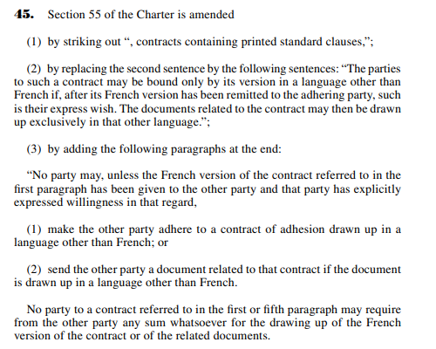

What the law stipulates Article 45 of the French Language Charter
The FR contract must be sent before the EN one
The client must then explicitly state their preference for the EN version
Extract from Projet de loi no 96
«LOI SUR LA LANGUE OFFICIELLE ET COMMUNE DU QUÉBEC, LE FRANÇAIS»

Slide 4
What the law stipulates Articles 2984 and 3006 of the Civil Code of Quebec
2984. The registration requisitions must be signed, certified, and submitted in accordance with the provisions of the law, this title, or the regulations.
The registration requisitions must be drafted exclusively in French.
3006. When the law requires that the requisition be submitted with documents, these documents, if written in a language other than French, must also be accompanied by a certified translation in Quebec.
Publications in the RDPRM (PPSA in Quebec) must be made entirely in French, even if the contract is in English.
The description of the goods in the RDPRM must match with what’s on the contract, which is why there is a requirement to describe the goods in French on a contract written in English.
Extract from Projet de loi no 96
«LOI SUR LA LANGUE OFFICIELLE ET COMMUNE DU QUÉBEC, LE FRANÇAIS»

Slide 5
Policies and Guideline
All information related to the law is available on Audit Board under Cross Comply and can be found in:
Documentation and Security Policy
Validation Policy
Document Quality Guideline

Slide 6
How to determine if Bill 96 applies
Determining factors for whether a contract is concluded in Quebec and, therefore, whether Bill 96 applies:
The client (company) is based in Quebec
Head office in Quebec / Corp Profile in Quebec (REQ)
The signatory resides in Quebec
Quebec ID / QC Address
The equipment will be used and/or plated in Quebec
There will be a publication in the RDPRM
A personal guarantee is included in the contract, and the guarantor resides in Quebec.
The process outlined in Bill 96 must be followed for both the contract and the guarantee document (for guarantor only-not applicable if the client isn’t in Quebec)
*The law doesn’t apply for a Qc Dealer signing a SSC, a buyback agreement, etc.

Slide 7
Guidelines
To accept a contract in English concluded in Quebec, we will need the following documentation in the file:
Proof that the client first received the French version and then requested the English version
Accepted proof: email chain from the client stating their preference for the English version over the French version, with the attached contract(s) that can be clicked and opened for verification.
Description of the equipment in French on the contract
Brand & Model can be in their original langage/version
We must be able to prove that the word refers to a brand name and/or model (web search)
If we encounter an acronym such as “VIN” instead of “NIV,” or “SUV” instead of “VUS,” for example, we can manually correct it without returning it to the client. But we must ensure compliance with the PPSA (FR)
No return to the client is necessary for initials in cases of clerical errors. We are entitled to make these corrections based on Clause 3 of our contracts.

Slide 8
Guidelines
2.1 Description of the Equipment in French on the Contract – If the contract refers to an invoice
A French invoice must be obtained;
OR
If we are unable to obtain the invoice in French, the person issuing the contract must manually prepare a regular Appendix A with the description in French

Slide 9
Guidelines
3. Full Drafting of the RDPRM needs to be in French
Our name in its French version
If the client has a legal name in French, use that one (not DBA)
Description of the equipment in French
General Collateral in French

Slide 10
Translation tools
Internal Glossary: Glossaire - Mitsubishi HC Capital
Website of the Office of the French Language: La Vitrine linguistique de l’Office québécois de la langue française
Canadian Translation Website: TERMIUM Plus®

Slide 11
Potential consequences of non-compliance with the law:
Non-French word registration: The RDPRM could refuse our registration request, and we would be informed too late, putting us in an unsecured position with a financed contract not registered within the 7-day deadline.
Registration in French in Quebec but a contract with equipment description in English: Inconsistency between what is on the contract and what we register, affecting the validity of our registration and contract.
The client or a third party could invalidate the contract in court if they find a loophole in the application of the law. If this leads to the contract being invalidated by the court, word could spread and create a precedent.
The OQLF (Quebec government agency) is increasingly conducting audits and investigations in businesses to ensure compliance with the law. They are authorized to impose fines of up to $30,000.
No, there is still no case law to guide us on how the courts interpret this law.

Slide 12

Questions

